Slide 1
A personal finance management app
-K.SREE SAI SRAVANI
121322033007

Slide 2
DESCRIPTION
A personal finance management app helps individuals manage their financial health by tracking income, expenses, savings, and investments. It typically provides features such as budget planning, bill reminders, financial goal setting, and expense categorization.
The main goal of such an app is to simplify the process of managing finances and improve financial literacy. For example, users can set savings goals, track progress, and receive notifications when they approach their financial limits, helping to reduce overspending.
AI-driven Insights: Integrating AI to provide personalized financial advice based on spending patterns, goals, and market trends
Investment Tracking: Expanding features to include portfolio management, tracking investments, and suggesting low-risk investment opportunities.
Credit Score Monitoring: Adding tools for users to track and improve their credit score, offering actionable tips.
Cross-Platform Integration: Ensuring seamless synchronization across multiple devices and platforms for better accessibility.
Financial Education: Offering in-app resources, such as articles or videos, to help users learn more about personal finance management.

Slide 3
Main Activity.java:
package com.example.expensestracker.ui.theme
import androidx.compose.ui.graphics.Color
val Purple200 = Color(0xFFBB86FC)
val Purple500 = Color(0xFF6200EE)
val Purple700 = Color(0xFF3700B3)
val Teal200 = Color(0xFF03DAC5)
package com.example.expensestracker.ui.theme
import androidx.compose.foundation.shape.RoundedCornerShape
import androidx.compose.material.Shapes
import androidx.compose.ui.unit.d
val Shapes = Shapes(
small = RoundedCornerShape(4.dp),
medium = RoundedCornerShape(4.dp),
large = RoundedCornerShape(0.dp)
) package com.example.expensestracker.ui.theme
import androidx.compose.foundation.isSystemInDarkTheme
import androidx.compose.material.MaterialTheme
import androidx.compose.material.darkColors
import androidx.compose.material.lightColors
import androidx.compose.runtime.Composable

Slide 4
private val DarkColorPalette = darkColors(
primary = Purple200,
primaryVariant = Purple700,
secondary = Teal200
)
private val LightColorPalette = lightColors(
primary = Purple500,
primaryVariant = Purple700,
secondary = Teal200
/* Other default colors to override
background = Color.White,
surface = Color.White,
onPrimary = Color.White,
onSecondary = Color.Black,
onBackground = Color.Black,
onSurface = Color.Black,
*/
)

Slide 5
@Composable
fun ExpensesTrackerTheme(
darkTheme: Boolean = isSystemInDarkTheme(),
content: @Composable () -> Unit
) {
val colors = if (darkTheme) {
DarkColorPalette
} else {
LightColorPalette
}
MaterialTheme(
colors = colors,
typography = Typography,
shapes = Shapes,
content = content
)
}
Actively main.xml

Slide 6
<?xml version="1.0" encoding="utf-8"?>
<manifest xmlns:android="http://schemas.android.com/apk/res/android"
xmlns:tools="http://schemas.android.com/tools">
<application
android:allowBackup="true"
android:dataExtractionRules="@xml/data_extraction_rules"
android:fullBackupContent="@xml/backup_rules"
android:icon="@mipmap/ic_launcher"
android:label="@string/app_name"
android:supportsRtl="true"
android:theme="@style/Theme.ExpensesTracker"
tools:targetApi="31">
<activity
android:name=".RegisterActivity"
android:exported="false"
android:label="@string/title_activity_register"
android:theme="@style/Theme.ExpensesTracker" />
<activity
android:name=".MainActivity"
android:exported="false"
android:label="MainActivity"
android:theme="@style/Theme.ExpensesTracker" />

Slide 7
<activity
android:name=".ViewRecordsActivity"
android:exported="false"
android:label="@string/title_activity_view_records"
android:theme="@style/Theme.ExpensesTracker" />
<activity
android:name=".SetLimitActivity"
android:exported="false"
android:label="@string/title_activity_set_limit"
android:theme="@style/Theme.ExpensesTracker" />
<activity
android:name=".AddExpensesActivity"
android:exported="false"
android:label="@string/title_activity_add_expenses"
android:theme="@style/Theme.ExpensesTracker" />
<activity
android:name=".LoginActivity"
android:exported="true"
android:label="@string/app_name"
android:theme="@style/Theme.ExpensesTracker">
<intent-filter>

Slide 8
<action android:name="android.intent.action.MAIN" />
<category android:name="android.intent.category.LAUNCHER" />
</intent-filter>
</activity>
</application>
</manifest>
Activity_main.xml:
package com.example.expensestracker
import android.annotation.SuppressLint
import android.content.Context
import android.content.Intent
import android.os.Bundle
import android.util.Log
import androidx.activity.ComponentActivity
import androidx.activity.compose.setContent
import androidx.compose.foundation.layout.*
import androidx.compose.foundation.lazy.LazyColumn
import androidx.compose.foundation.lazy.LazyRow

Slide 9
import androidx.compose.material.*
import androidx.compose.runtime.*
import androidx.compose.ui.Alignment
import androidx.compose.ui.Modifier
import androidx.compose.ui.graphics.Color
import androidx.compose.ui.text.font.FontWeight
import androidx.compose.ui.text.style.TextAlign
import androidx.compose.ui.unit.dp
import androidx.compose.ui.unit.sp
import com.example.expensestracker.ui.theme.ExpensesTrackerTheme
class SetLimitActivity : ComponentActivity() {
private lateinit var expenseDatabaseHelper: ExpenseDatabaseHelper
@SuppressLint("UnusedMaterialScaffoldPaddingParameter")
override fun onCreate(savedInstanceState: Bundle?) {
super.onCreate(savedInstanceState)
expenseDatabaseHelper = ExpenseDatabaseHelper(this)
setContent {
Scaffold(
// in scaffold we are specifying top bar.
bottomBar = {
// inside top bar we are specifying

Slide 10
// background color.
BottomAppBar(backgroundColor = Color(0xFFadbef4),
modifier = Modifier.height(80.dp),
// along with that we are specifying
// title for our top bar.
content = {
Spacer(modifier = Modifier.width(15.dp))
Button(
onClick = {
startActivity(
Intent(
applicationContext,
AddExpensesActivity::class.java
)
)
},
colors = ButtonDefaults.buttonColors(backgroundColor=Color.White),
modifier = Modifier.size(height = 55.dp, width = 110.dp)
)

Slide 11
{
Text(
text = "Add Expenses", color = Color.Black, fontSize = 14.sp,
textAlign = TextAlign.Center
)
}
Spacer(modifier = Modifier.width(15.dp))
Button(
onClick = {
startActivity(
Intent(
applicationContext,
SetLimitActivity::class.java
)
)
},
colors = ButtonDefaults.buttonColors(backgroundColor = Color.White),
modifier = Modifier.size(height = 55.dp, width = 110.dp)
)

Slide 12
{
Text(
text = "Set Limit", color = Color.Black, fontSize = 14.sp,
textAlign = TextAlign.Center
)
}
Spacer(modifier = Modifier.width(15.dp))
Button(
onClick = {
startActivity(
Intent(
applicationContext,
ViewRecordsActivity::class.java
)
)
},
colors = ButtonDefaults.buttonColors(backgroundColor = Color.White),
modifier = Modifier.size(height = 55.dp, width = 110.dp)
)

Slide 13
{
Text(
text = "View Records", color = Color.Black, fontSize = 14.sp,
textAlign = TextAlign.Center
)
}
}
)
}
) {
val data=expenseDatabaseHelper.getAllExpense();
Log.d("swathi" ,data.toString())
val expense = expenseDatabaseHelper.getAllExpense()
Limit(this, expenseDatabaseHelper,expense)
}
}
}
}
@Composable
fun Limit(context: Context, expenseDatabaseHelper: ExpenseDatabaseHelper, expense: List<Expense>) {

Slide 14
Column(
modifier = Modifier
.padding(top = 100.dp, start = 30.dp)
.fillMaxHeight()
.fillMaxWidth(),
horizontalAlignment = Alignment.Start
) {
var amount by remember { mutableStateOf("") }
var error by remember { mutableStateOf("") }
Text(text = "Monthly Amount Limit", fontWeight = FontWeight.Bold, fontSize = 20.sp)
Spacer(modifier = Modifier.height(10.dp))
TextField(value = amount, onValueChange = { amount = it },
label = { Text(text = "Set Amount Limit ") })
Spacer(modifier = Modifier.height(20.dp))
if (error.isNotEmpty()) {
Text(
text = error,

Slide 15
color = MaterialTheme.colors.error,
modifier = Modifier.padding(vertical = 16.dp)
)
}
Button(onClick = {
if (amount.isNotEmpty()) {
val expense = Expense(
id = null,
amount = amount
)
expenseDatabaseHelper.insertExpense(expense)
}
}) {
Text(text = "Set Limit")
}
Spacer(modifier = Modifier.height(10.dp))
LazyRow(
modifier = Modifier
.fillMaxSize()
.padding(top = 0.dp),
horizontalArrangement = Arrangement.Start
) {

Slide 16
item {
LazyColumn {
items(expense) { expense ->
Column(
) {
Text("Remaining Amount: ${expense.amount}", fontWeight = FontWeight.Bold)
}
}
}
}
}
}
}

Slide 17
<vector xmlns:android="http://schemas.android.com/apk/res/android"
xmlns:aapt="http://schemas.android.com/aapt"
android:width="108dp"
android:height="108dp"
android:viewportWidth="108"
android:viewportHeight="108">
<path android:pathData="M31,63.928c0,0 6.4,-11 12.1,-13.1c7.2,-2.6 26,-1.4 26,-1.4l38.1,38.1L107,108.928l-32,-1L31,63.928z">
<aapt:attr name="android:fillColor">
<gradient
android:endX="85.84757"
android:endY="92.4963"
android:startX="42.9492"
android:startY="49.59793"
android:type="linear">
<item
android:color="#44000000"
android:offset="0.0" />
<item
android:color="#00000000"
android:offset="1.0" />
</gradient>
</aapt:attr>
</path>

Slide 18
buildscript {
ext {
compose_ui_version = '1.2.0'
}
}// Top-level build file where you can add configuration options common to all sub-projects/modules.
plugins {
id 'com.android.application' version '7.4.1' apply false
id 'com.android.library' version '7.4.1' apply false
id 'org.jetbrains.kotlin.android' version '1.7.0' apply false
}
package com.example.expensestracker
import androidx.room.ColumnInfo
import androidx.room.Entity
import androidx.room.PrimaryKey
@Entity(tableName = "user_table")
data class User(
@PrimaryKey(autoGenerate = true) val id: Int?,
@ColumnInfo(name = "first_name") val firstName: String?,
@ColumnInfo(name = "last_name") val lastName: String?,
@ColumnInfo(name = "email") val email: String?,
@ColumnInfo(name = "password") val password: String?,)

Slide 19
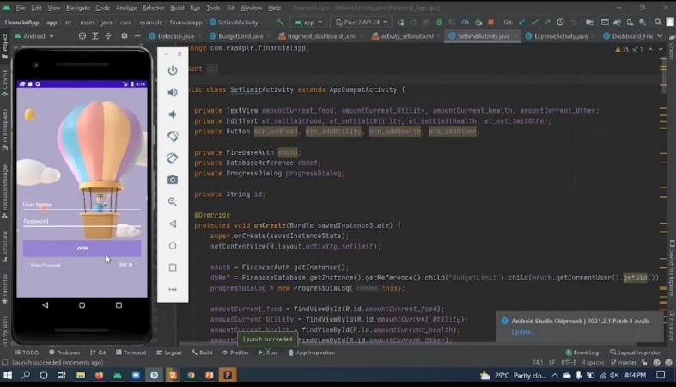
OUTPUT:

Slide 20
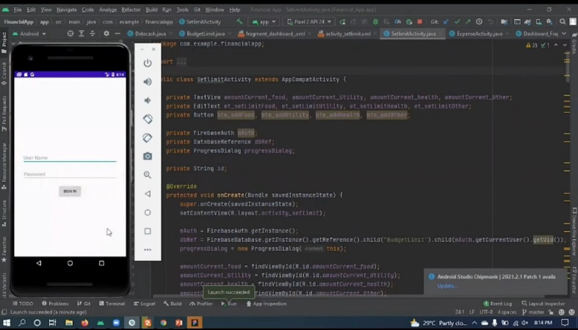

Slide 21
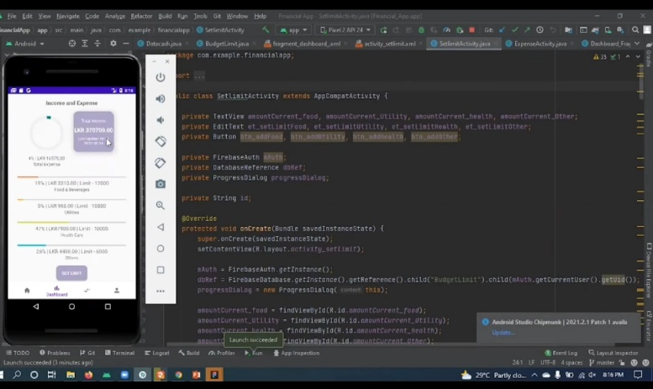

Slide 22
